Slide 1

30 November – 4 December 2026
International Conference Centre, Maiduguri
EXHIBITION STRATEGY & PARTNERSHIP PROPOSAL
Proposed Strategies for Hosting a Successful Exhibition and Attracting Sponsorship and Partners.
Chairman, Conference Planning Committee
Exhibition Sub-Committee
Engr Dayo Olugboye
Exhibition Consultant
22 July 2026

Slide 2
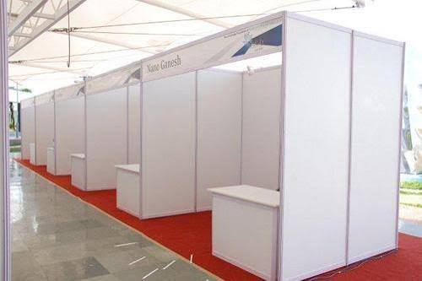

Exhibition Booth/Stand
Partners/Sponsors: Frontline spaces will be provided to partners for custom stands.
Shell Scheme: A typical shell scheme would be used if logistics goes well, as it will come from Abuja or Kano.
Framed Stand: This could be constructed on-site using materials sourced from the local market.
STRATEGY FOR HOSTING & PARTNERSHIP
NSE × CPC · 06 / 16

Slide 3
03 · Proposed Target of Exhibition
Exhibition Value Proposition
Maiduguri 2026 Exhibition is a platform within the NSE International Conference framework to promote partnerships, professional networking, and business relationships that harness the Borno people's entrepreneurial and technological prowess, while exposing new opportunities, technologies, and broader markets.
Security & Defense Sector
Agro-allied & Industrial Sector
The Nigerian Defence Industrial Complex, which manufactures security and defence equipment, surveillance systems and hardware, has a unique opportunity to align with the Borno State Government’s post-conflict strides and showcase new capabilities.
The Agro-allied, extractives, and industrial sectors can harness enormous growth opportunities to meet rising demand driven by population growth and reconstruction efforts, as well as the massive need for technical solutions and expertise.
Borno SMEs & MSMEs
Construction Technologies
The Government of Borno invested in SMEs and MSMEs to stimulate the economy and drive innovation, economic viability and income generation. SMEs in Borno have much to show the world in terms of resilience and success.
It is time to recognise and showcase Non-Governmental bodies and contractors providing unique solutions for resettlement, healthcare and post-trauma management, risk mitigation in IED-infected communities, water purification, environmental renewal, detoxification and housing solutions.
NSE × CPC · 10 / 16

Slide 4
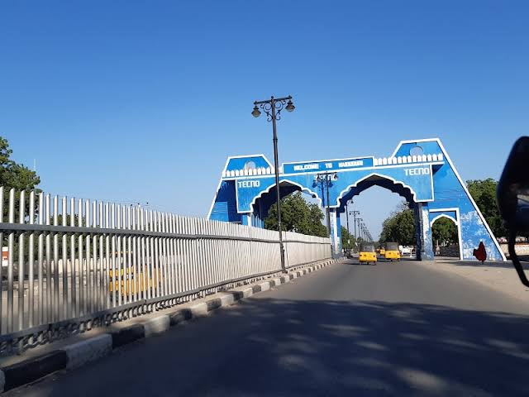

02 ·Maiduguri 2026
About Maiduguri
Ready to host the rest of Nigeria
Daily flight into Maiduguri
-
Standard Hotels at friendly rates
-
Electric Vehicles Taxi’s
-
Excellent Network of Roads and Location Service
-
State Government Supported Event
-
    State Capital
World Class Conference Facility
-
    Home of Hospitality
    Commercial Hub
Rich Culture, Cuisine and Craft
-
    Serene and Peaceful
STRATEGIC PARTNERSHIP PROPOSAL
NSE × 05/ 10

Slide 5

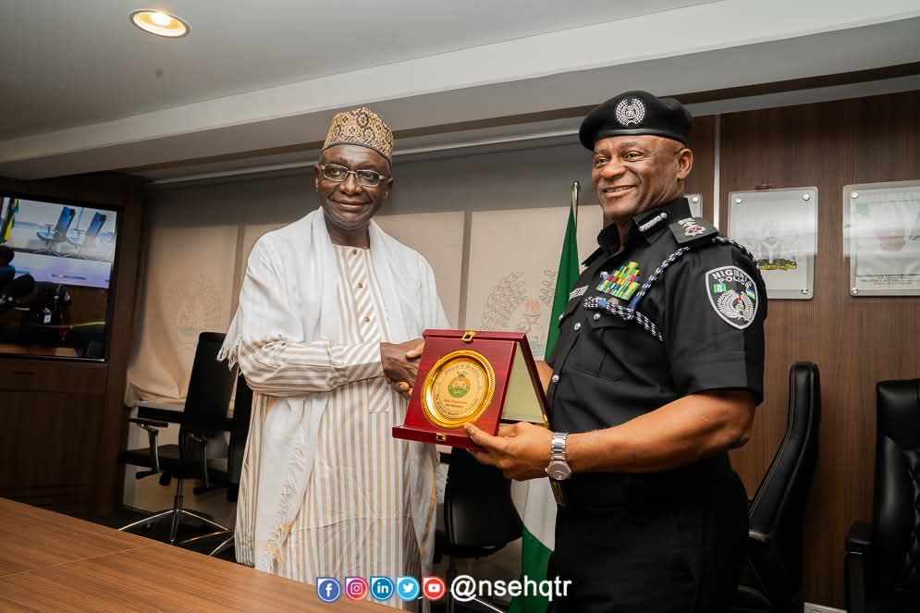
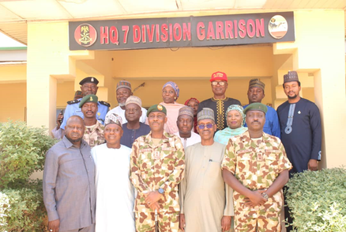
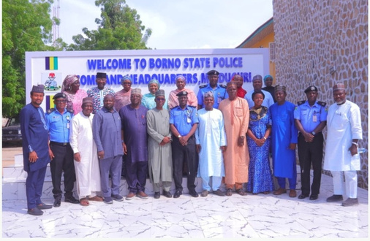
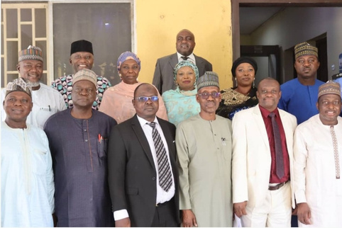
02 · Maiduguri 2026
Stakeholder Engagement & Readiness
NSE in active and progressive engagement and collaboration with key stakeholders to ensures a safe, hitch-free and successful conference.
01
02
Borno State Government &
Agencies
The Ministry of Defense & Military
03
04
Nigeria Police Force
Department of State Services
ENGR ALI A. RABIU FNSE, MON, PRESIDENT OF NSE WITH GEN. CHRIS G. MUSA (RTD.) OFR, KEYNOTE SPEAKER FOR MAIDUGURI 2026
CONFERENCE PLANNING COMMITTEE VISIT TO THE STATE DIRECTOR, DEPARTMENT OF STATE SERVICES, BORNO STATE
05
06
Emergency Response Agencies & Fire Services
Traditional Institutions
07
08
Chamber of Commerce &
Industries
NSCDC & Paramilitary Agencies
CONFERENCE PLANNING COMMITTEE VISIT TO GARRISON COMMANDER, 7 DIV, NIGERIAN ARMY, MAIDUGURI
CONFERENCE PLANNING COMMITTEE VISIT TO COMMISSIONER OF POLICE, BORNO STATE COMMAND, CP NAZIRU ABDULMAJID
CONFERENCE PLANNING COMMITTEE VISIT TO THE STATE DIRECTOR, DEPARTMENT OF STATE SERVICES, BORNO STATE
STRATEGIC PARTNERSHIP PROPOSAL
NSE × 06 / 10

Slide 6
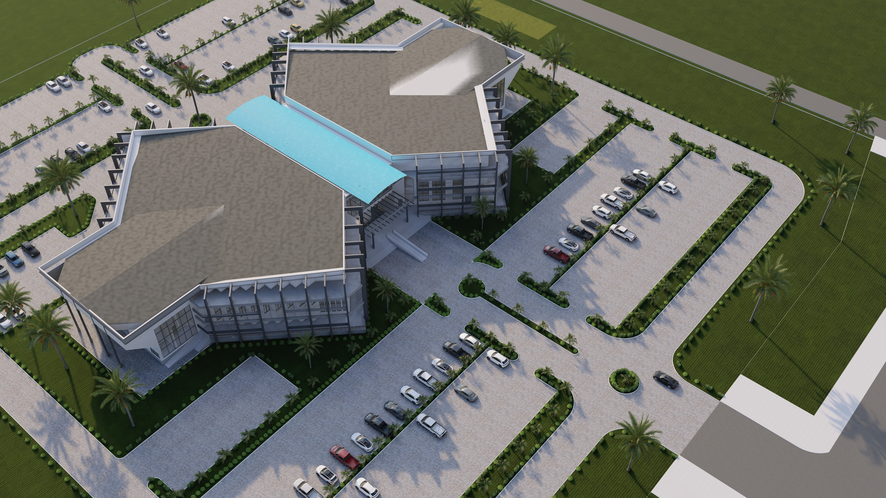
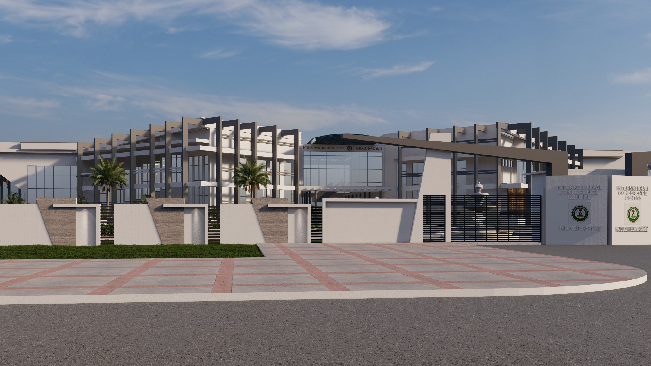
02 ·Maiduguri 2026
Ready to host the rest of Nigeria
Conference Facility
International Conference Centre, Maiduguri
-
Conference – Parking - Accommodation
-
Located along the Maiduguri Airport road
-
Centre of Town and hub of commercial activities
-
Brand-new, World-Class Conference Facility
-
Indoor Conference facility, Exhibition pavilion, Outdoor display and Marketplace.
-
-
STRATEGIC PARTNERSHIP PROPOSAL
NSE × 07/ 10

